Slide 1

Assistive Technology Works: Legislation, Definitions and Benefits
Virginia Department of Education
Assistive Technology Priority Project
Notes:
Assistive Technology Works: Legislation, Definitions and Benefits is a brief introduction to the laws around assistive technology, otherwise referred to as AT, and how AT benefits students with disabilities. This presentation was developed by the Virginia Department of Education’s Assistive Technology Priority Project.

Slide 2
Check your knowledge…
  Answer true or false to the following statements.
  ___Assistive technology (AT) was first defined in IDEA in 1990.
  ___ According to federal law, assistive technology applies only to individuals with disabilities.
  ___Assistive technology is defined as any device that is used to increase, maintain, or improve the functional capabilities of a child with a disability.
  ___Assistive technology can be beneficial in all academic and functional areas except behavior and transition planning.
  ___It is important to actively involve students in their own AT planning.
  .
Answers will be provided at the end of the video.
Notes:
Check your knowledge with this brief quiz/pre-test. Pass out paper copies of this quiz to participants. Answers are provided at the end of the video and on the answer sheet.

Slide 3

Technology Creates Opportunities
Notes:
Almost every person’s life has been affected by the technology revolution that began in the 1980’s, from the use of portable computers to cell phones.

Slide 4


Technology has changed the way we do things
Notes:
Access to information in school environments has improved exponentially through the World Wide Web and digital media sources.

Slide 5

More examples of technology
Notes:
These technology innovations have provided greater opportunities for individuals with disabilities to achieve success in school, be successfully employed, and be active members of the community.

Slide 6

AT Legislation
Technology Related Assistance for Individuals with Disabilities Act of 1988 (Tech Act- P.L. 100-407)
Assistive Technology Act of 1998 (P.L. 105-394)
Individuals with Disabilities Education Act, 1990 (P.L. 101-476) and 1997 (P.L. 105-17)
Individuals with Disabilities Improvement Act of 2004 (P.L. 108-446)
Notes:
Public schools have been involved in the provision of AT devices and services for many years. Federal legislation such as the Technology-Related Assistance for Individuals with Disabilities Act of 1988 and the Assistive Technology Act of 1998 were the first laws to specifically address the technology related needs of persons with disabilities and define AT devices and services. The Individuals with Disabilities Education Act of 1990 and 1997 and the Individuals with Disabilities Improvement Act of 2004 emphasize the value of assistive technology and the responsibility of schools to meet the needs of children with disabilities for a free-appropriate public education through the use of assistive technology devices and services. In addition, they more specifically address AT in educational environments and require IEP teams to consider the need for AT for every individual with a disability.

Slide 7
What is Assistive Technology?
According to IDEA (1997) and the Regulations Governing Special Education Programs for Children with Disabilities in Virginia, an AT device is defined as:
“any item, piece of equipment, or product system, whether acquired commercially off the shelf, modified, or customized, that is used to increase, maintain, or improve the functional capabilities of a child with a disability.”
Notes:
The law places equal weight on devices and services. An AT device can be any piece of equipment whether purchased through a specialized AT catalog or at a local discount store.

Slide 8
Clarification
In the 2004 revision of IDEA, the Individuals with Disabilities Education Improvement Act (IDEIA), the following clarification was added to the definition of an AT device:
The term does not include a medical device that is surgically implanted, or the replacement of such device.
Notes:
In 2004, the law further clarifies the definition of an AT device to NOT include a medical device that has been surgically implanted.

Slide 9
AT Services
According to IDEA (1997) and the Regulations Governing Special Education Programs for Children with Disabilities in Virginia, an AT service is defined as:
“any service that directly assists a child with a disability in the selection, acquisition, or use of an assistive technology device.”
Including:
Evaluation
Acquisition of assistive technology devices
Customizing and repairing devices
Coordinating with other therapies and existing educational and rehabilitation plans and programs
Training or technical assistance for a child, family and professionals
Notes:
An AT services includes evaluation, purchasing and leasing devices, repairing devices, coordination with other programs and training and technical assistance for the student, family and other professionals. It is important that AT devices and services be defined for students.

Slide 10


These broad definitions allow IEP teams the flexibility to provide a range of AT devices (and services) from low to high tech to support student performance in academic and functional areas.
high tech
low tech
Notes:
These broad definitions allow IEP teams the flexibility to provide a range of AT devices (and services) from low to high tech to support student performance in academic and functional areas. Low tech devices are considered to be less complex, less expensive and require little training (such pencil grips and highlighters.) High tech devices are more costly, complex, involve computer technology and require a higher degree of training. Devices that range between high and low tech are considered by some to be mid-tech devices. Most decisions about AT devices and services typically result in easily accessible AT and widely available technology. Examples include: organizational tools, graphic organizers, highlighters, sticky notes, and the use of accessibility features in word processing programs, etc. Some students require higher tech devices such as customized computers and complex augmentative communication devices. All decisions about assistive technology should be supported by data and device trials.

Slide 11

Areas of Need
Consideration of devices should include, but not be limited to the following areas of need:
Literacy and Numeracy
Study/Organizational Skills
Listening and Communication
Activities of Daily Living
Recreation, Leisure, and Adaptive Play
Positioning, Seating, and Mobility
Computer Access
Behavior and Transition
Notes:
Consideration of devices should include, but not be limited to the following areas of need:
Literacy and Numeracy
Study and Organizational Skills
Listening and Communication
Activities of Daily Living
Recreation, Leisure, and Adaptive Play
Positioning, Seating, and Mobility
Computer Access
And Behavior and Transition
In addition, AT can be useful for a person with challenging behavior to help keep them actively engaged in activities and prevent frustrations that can lead to behavior incidents.
Transition planning is another important area for AT consideration. Transitions occur throughout our lives, from early intervention to school and school to post secondary activities. With every transition, comes new tasks and routines and an opportunity for AT to support student success and independence.

Slide 12
Pause for a moment and answer these questions…
Are your students using assistive technology? If so, what devices are they using? Are these devices considered low tech or high tech? How are these devices helping your students?
Do your students receive any AT services? If so, what AT services and who provides them?
Notes:
Turn to a partner and answer these questions.

Slide 13

Who benefits from AT?
Anyone with an identified disability, including
anyone who would experience greater success with an accommodation or modification
Notes:
So, who really benefits from assistive technology? The law interprets assistive technology to benefit anyone with an identified disability, including anyone who is having difficulty in a skill area and who would experience greater success with an accommodation or modification. The benefits cross age, grade, and all disability areas. Let’s look at some students who have benefited from the use of AT in educational settings

Slide 14
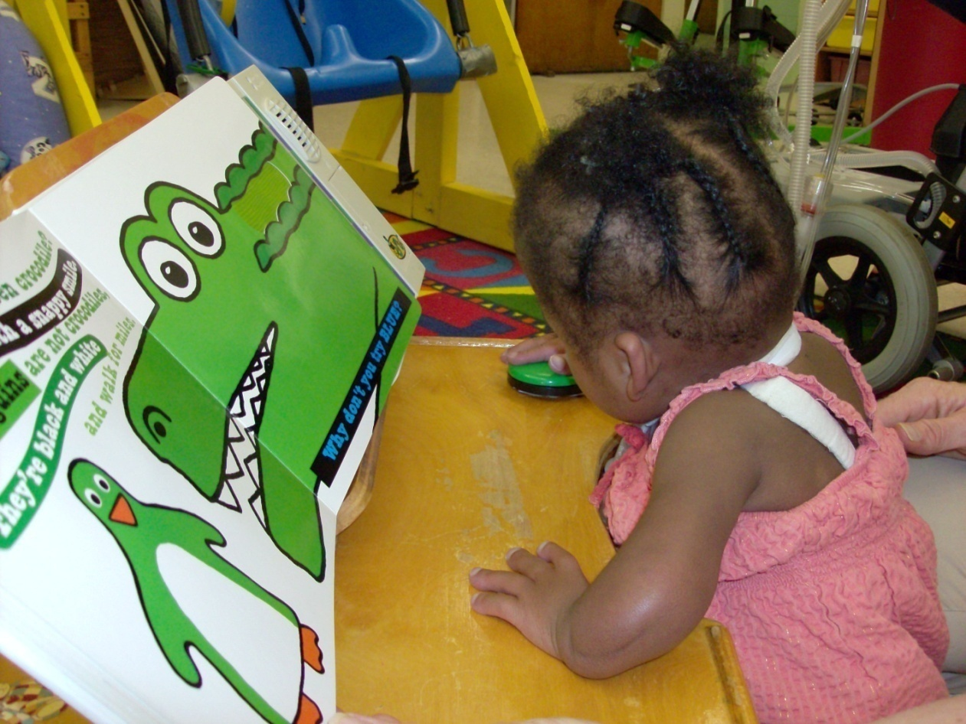
Shana is a 3 year old child who has difficulty sitting up without support, talking and interacting with books.
Notes:
Shana is a 3 year old girl who receives educational services in a self-contained special education classroom. She receives occupational therapy, physical therapy and speech therapy. Shana has difficulty sitting up without support, turning pages of books and talking.

Slide 15
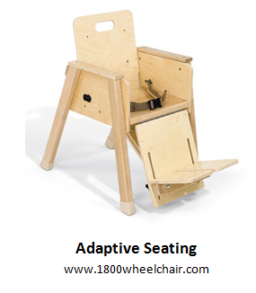
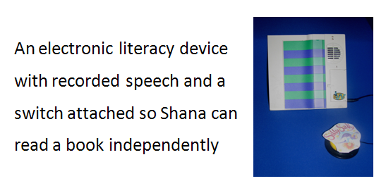
AT Solutions (page 2)
Notes:
With the help of adaptive seating and a switch attached is an electronic literacy tool, Shana is able to independently use the switch to read the book.

Slide 16
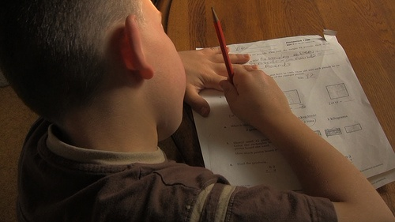
John is a fourth grade student who struggles with reading, spelling and writing.
Notes:
John is a fourth grade student with an IEP. He experiences educational challenges in the areas of reading, writing and spelling. He has difficulty writing a short paragraph of 2-3 sentences on a topic area. He also has trouble spelling high frequency sight words and applying word analysis skills when reading. He reads on a 2nd grade level. He has difficulty with reading comprehension but his listening comprehension is average. John was given sentence starters, word banks, a personal dictionary, a reduced number of spelling words, and extra time to complete his work. However, John was still not able to produce the amount of writing required for a 4th grade student.

Slide 17
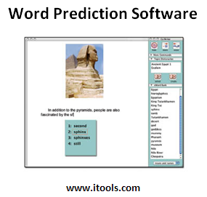
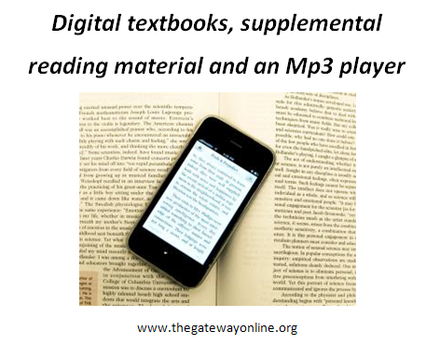
AT Solutions
Notes:
His IEP team explored a variety of software programs and kept data to determine which technologies were most effective. John experienced success using word prediction software to help with spelling. He is now able to keep up with fourth grade reading materials with the use of an mp3 player and digital textbooks.

Slide 18

Sam is an 11th grade student with Asperger’s Syndrome. He plans to attend college. He has difficulty with note taking and organization.
Notes:
Sam is a high school student with career goals that require a college education. He is concerned about his difficulties with note taking and organization. Sam worked with his IEP team to try out software programs and other AT devices that could help with note taking.

Slide 19
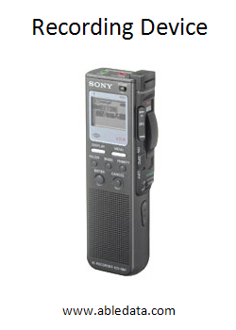
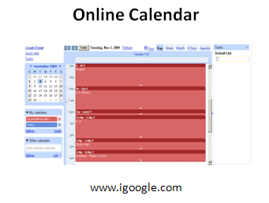
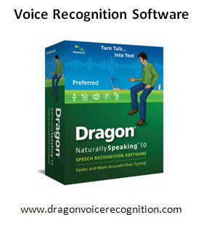
AT Solutions (page 3)
Notes:
After trying a variety of assistive technologies, Sam found it helpful to use a recording device with voice recognition software to record notes in class and then transfer his class notes to his computer. Since he already has a small portable computer, he decided an online calendar would be easier for him to maintain. Training was provided to Sam, his family and his teachers on these AT devices so they could support him at home and at school.

Slide 20

Benefits of Assistive Technology
Improves school performance
Provides access to the general education curriculum
Improves communication
Helps individuals successfully complete tasks
Helps individuals achieve goals that may not have been possible
Notes:
There are many benefits of assistive technology as evident by the successes of Shana, John and Sam. But, there are also other benefits. Over the past 10 years, the percentage of students with disabilities served in schools and classes with their peers without disabilities has gradually increased and continues to grow. AT can help improve school performance in all academic areas. Something as simple as a multiplication or division table can help students succeed in math. AT provides access to the general education curriculum and helps students successfully complete tasks in academic and functional areas. For example, a student who struggles in the area of reading might use text to speech software to read important pieces of literature and access content in science and social studies. For students with communication difficulties, AT can improve communication success through the use of augmentative and alternative communication devices and materials. In essence, AT provides a voice for these students to express wants, needs and to share feelings and ideas. It also helps individuals articulate their goals and achieve goals that may not have been possible.

Slide 21

More Benefits of AT
Increases independence
Improves self-esteem and confidence
Enhances student satisfaction with school
Increases participation with peers
Notes:
Assistive technology helps students compensate for their areas of weakness and increases independence in school, work and home life. When students are more successful and independent, self-esteem and confidence are improved and students are more satisfied in school. Possibly one of the greatest benefits of AT is that it increases opportunities for students to participate with their peers

Slide 22

Making Decisions about Technology
Notes:
Over the years, well-meaning professionals and family members have often made choices, set goals and directed the educational lives of students with disabilities without regard for the students’ interests and preferences. These often involved making critical choices about AT devices and services without including the student in the decision-making process. Decisions made without the participation of students have led to the purchase of expensive AT devices that were poor choices for the students for a variety of reasons.

Slide 23

Self-Determination
Involve students early in their own AT selection
Student involvement in the selection of AT is critical in matching the appropriate tool to students needs and preferences
Involve students in evaluating their own learning styles, strengths, goals, and their need for AT as related to different environments and tasks
Tia Crowder (left) with her hero, Molly Jimerson, both fourth graders at Swift
Creek Elementary School.
(Lisa Billings/Chesterfield Observer)
Notes:
Actively involving students in AT assessments, AT trials and IEP meetings is critical; but even better AT decisions are made when the students have the skills, knowledge and confidence to communicate their own preferences and interests. Students who are self-determined have these skills.
Three things to remember about self-determination are:
Involve students early in their own AT selection
Student involvement in the selection of AT is critical in matching the appropriate tool to students needs and preferences
Involve students in evaluating their own learning styles, strengths, goals, and their need for AT as related to different environments and tasks.

Slide 24

Self-Determination (cont.)
When IEP teams are knowledgeable about assistive technology, it increases the likelihood of effective AT use and success for the student. For that reason, IEP team members should know
what AT is
the laws surrounding its use
and how it can impact a student’s
ability to acquire and demonstrate knowledge
Notes:
In conclusion, there is an abundance of easily accessible information on assistive technology selection and use. When IEP teams are knowledgeable about AT, it increases the likelihood of effective use and success for the student. For that reason, IEP team members should know what AT is, the laws surrounding its use, and how it can impact a student’s ability to acquire and demonstrate knowledge. It is important for students, professionals and families to know about the AT resources available in their local schools and programs.

Slide 25
Check your knowledge (answers)
  Answer true or false to the following statements.
  ___Assistive technology (AT) was first defined in IDEA in 1990.
  False. Although IDEA first defined the schools’ responsibility to provide AT to students with disabilities, it was the Technology Related Assistance for Individuals with Disabilities Act in 1988 that first defined AT devices and services for all individuals with disabilities.
  ___ According to federal law, assistive technology applies only to individuals with disabilities.
  True. Although assistive technology can be beneficial to all people, it is a term that specifically applies to individuals with disabilities.
Notes:
Review the following true and false statements and their answers.

Slide 26
Check your knowledge answers
(page 2)
  ___AT is defined as any device that is used to increase, maintain, or improve the functional capabilities of a child with a disability.
  False. AT is defined as both a device and a service.
  ___Assistive technology can be beneficial in all academic and functional areas except behavior and transition planning.
  False. AT can be beneficial in all academic and functional areas including behavior and transition planning.
  ___It is important to actively involve students in their own AT planning.
  True. Students should be involved early in their own AT planning in order to match the appropriate tools to students’ needs and preferences.

